Slide 1


Slide 2
PROBABILITY-2

Slide 3
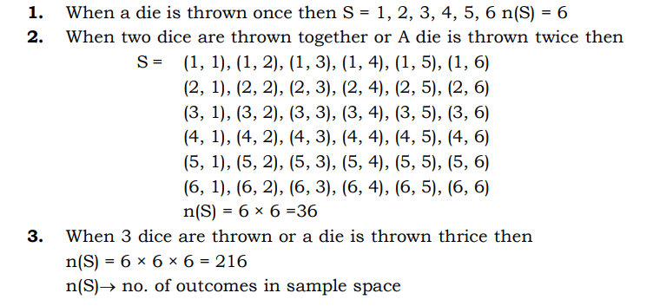
DICE BASED QUESTION:

Slide 4
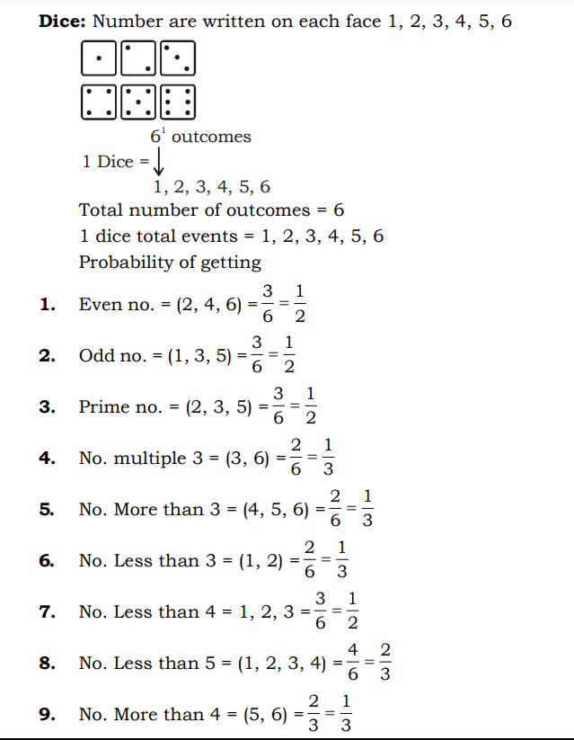

Slide 5
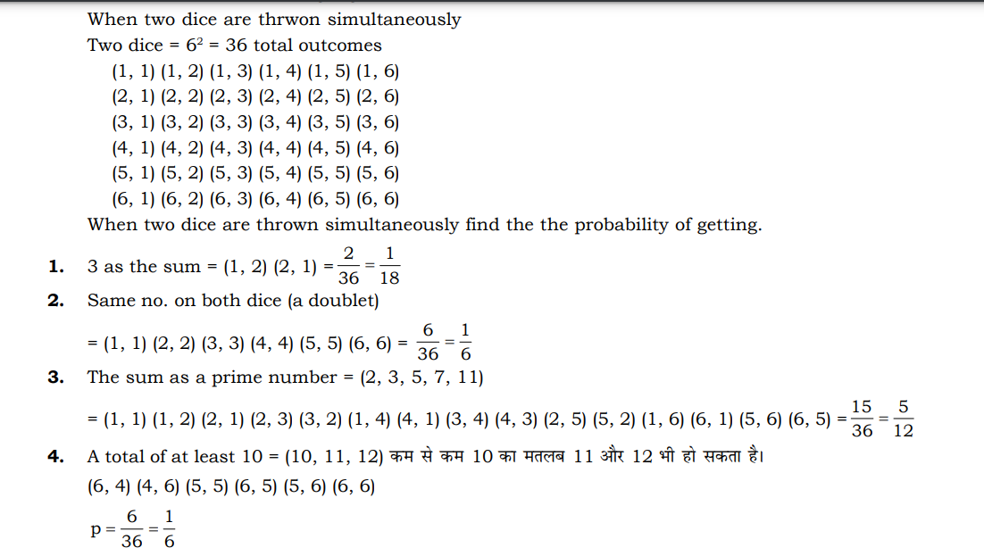
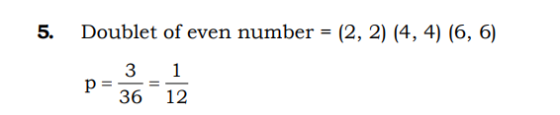

Slide 6
PRACTICE QUESTIONS:
1. A dice is tossed 4 times and the outcomes are recorded. How many possible outcomes
are there?
a) 216
b) 24
c) 1024
d) 1296
2. In a single throw of 2 dice, find the probability of getting a total of 3 or 5?
1/6
4/6
1/36
None of these
Notes:
Ans: 1. d) 1296
2. a) 1/6

Slide 7
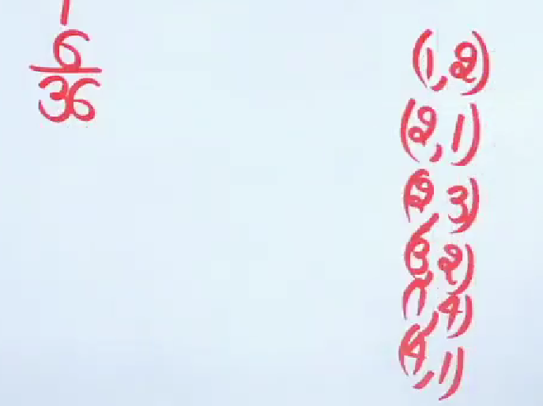
ANSWER:

Slide 8
PRACTICE QUESTIONS:
3. A dice is thrown, find the probability of getting-
A composite number
1/2
1/3
1/4
1/5
4. A number not divisible by 5
a) 1/6
b) 5/6
c) 1/2
d) None
Notes:
Ans: 3. b) 1/3
4. b) 5/6

Slide 9
PRACTICE QUESTIONS:
5. In a single throw of 2 dice, find the probability of getting a total of 8?
a) 1/36
b) 5/36
c) 3/36
d) 7/36
6. What is the probability of getting a sum 9 when a dice is thrown two times?
1/9
1/8
1/10
None of these
Notes:
Ans : 5. b) 5/36
6. a) 1/9

Slide 10
PRACTICE QUESTIONS:
7. Two dice are tossed. The probability that the total score is a prime number is?
a) 5/12
b) 1/6
c) 1/2
d) 7/9
8. Two dice are thrown together. What is the probability that the sum of the number on
the two faces is divided by 4 or 6?
a) 7/18
b) 7/35
c) 5/18
d) None of these
Notes:
Ans: 7. a) 5/12
8. a) 7/18

Slide 11
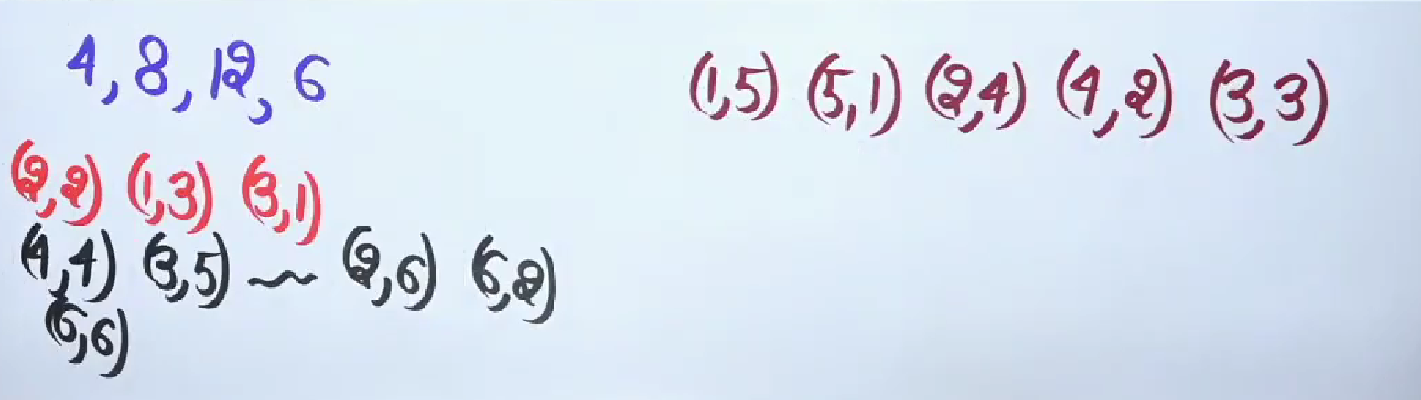
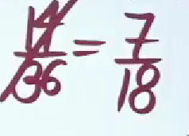
ANSWER:

Slide 12
PRACTICE QUESTIONS:
A dice is thrown twice and the sum of the appearing number is 6. Then the probability
that the number 4 has appeared at least once is?
¼
1/3
2/5
½
Notes:
Ans: c) 2/5

Slide 13
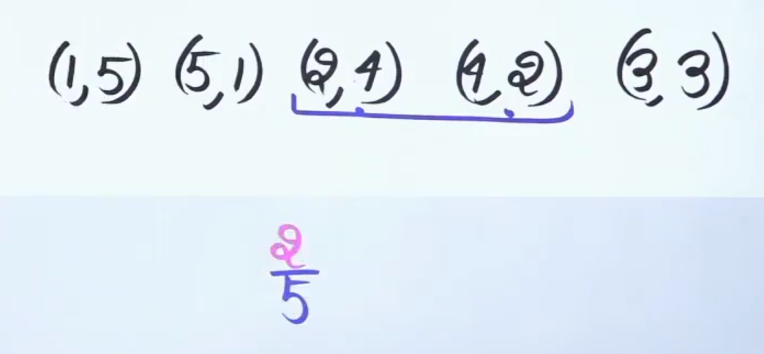
ANSWER:

Slide 14
PRACTICE QUESTION:
2 dice are thrown, find the possibility of getting-
1. Number on first dice is different from second dice.
1/6
2/3
5/6
4/3
2. Sum 8 when the number on first dice is greater than number on the second dice.
1/36
3/18
3/36
1/18
Notes:
c) 5/6
D) 1/18

Slide 15
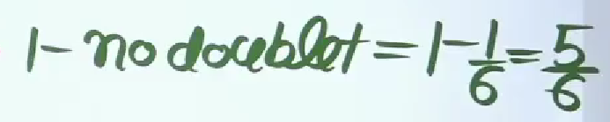
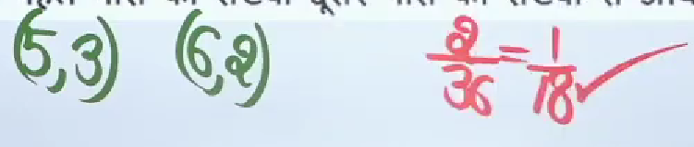
ANSWER:

Slide 16
PRACTICE QUESTIONS:
1. In a single throw of a pair of dice, the probability of getting the sum a perfect square
is?
1/18
7/36
1/6
2/9
2. Two dice are thrown simultaneously. What is the probability of obtaining sum of the
numbers less than 11?
17/18
1/12
11/12
None of these
Notes:
Ans: 1. b) 7/36
2. c) 11/12

Slide 17
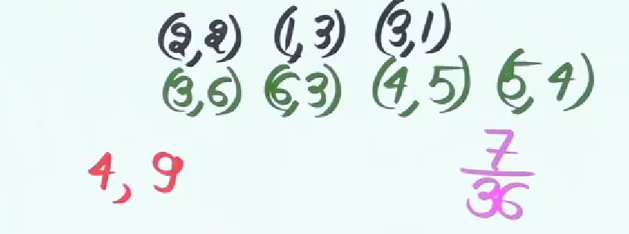
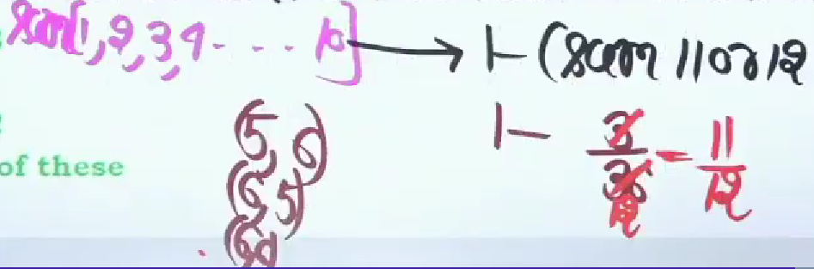
ANSWER:

Slide 18
PRACTICE QUESTION:
Two dice are thrown simultaneously. What is the probability of getting two
numbers whose product is even?
3/8
3/4
5/16
1/2
Notes:
Ans: b) ¾

Slide 19
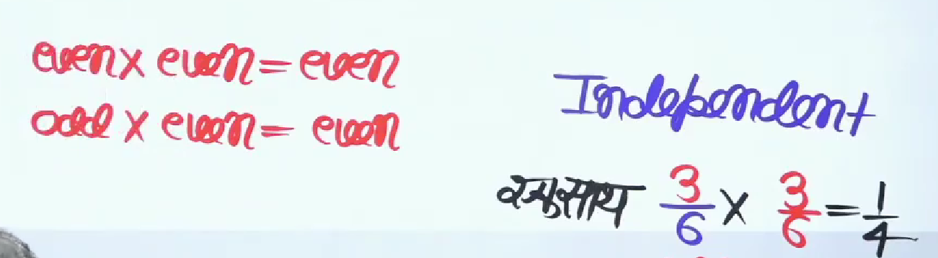
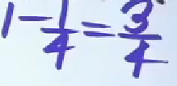
ANSWER:
Notes:
Ans: C) LAUNNCH

Slide 20
QUESTION
Two unbiased coins are tossed. What is the probability of getting at most one head?
A) 2/3
B) 1/2
C) 3/4
D) 4/3
Notes:
Correct Answer: 3/4

Slide 21
QUESTION
An unbiased die is tossed. Find the probability of getting a multiple of 3.
A) 1/4
B) 1/3
C) 1/2
D) 1
Notes:
Correct Answer: 1/3

Slide 22
QUESTION
In a simultaneous throw of a pair of dice, find the probability of getting a total more than 7
A) 3/2
B) 4/7
C) 5/12
D) 6/13
Notes:
Correct Answer: 5/12

Slide 23
QUESTION
The probability of getting at least one tail in 4 throws of a coin is?
A) 15/16
B) 1/16
C) 1/4
D) None of these
Notes:
Correct Answer: 15/16

Slide 24
QUESTION
Two dice are thrown together. What is the probability that the sum of the numbers on the two faces is divisible by 4?
A) 1/2
B) 1/4
C) 1/36
D) None
Notes:
Correct Answer: 1/4

Slide 25
PRACTICE QUESTIONS:
3 dice are thrown, probability of getting prime number on first dice, composite
number on second dice & odd number on 3rd dice?
1/12
1/2
1/3
None of these
Notes:
Ans: a) 1/12

Slide 26
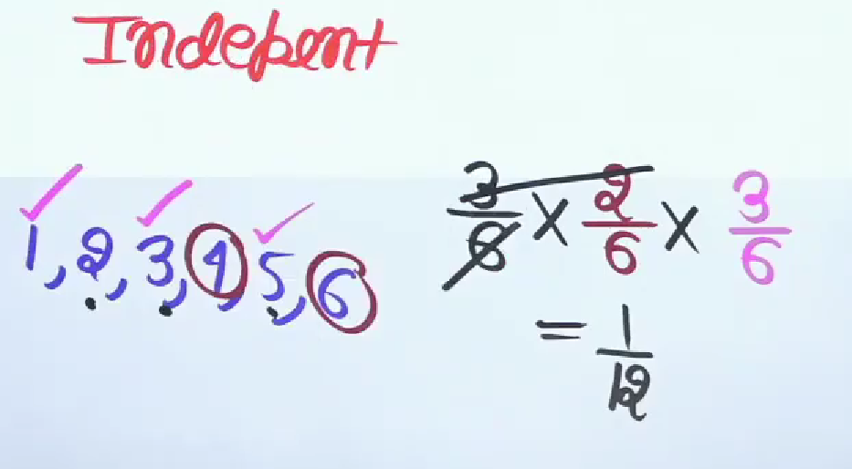
ANSWER:

Slide 27
PRACTICE QUESTIONS:
3 dice are thrown. If A appears on the first dice, B appears on the second dice
and C appear on the third dice. Find the probability of getting A<B<C?
10/27
5/54
19/216
7/105
Notes:
Ans: b) 5/54

Slide 28
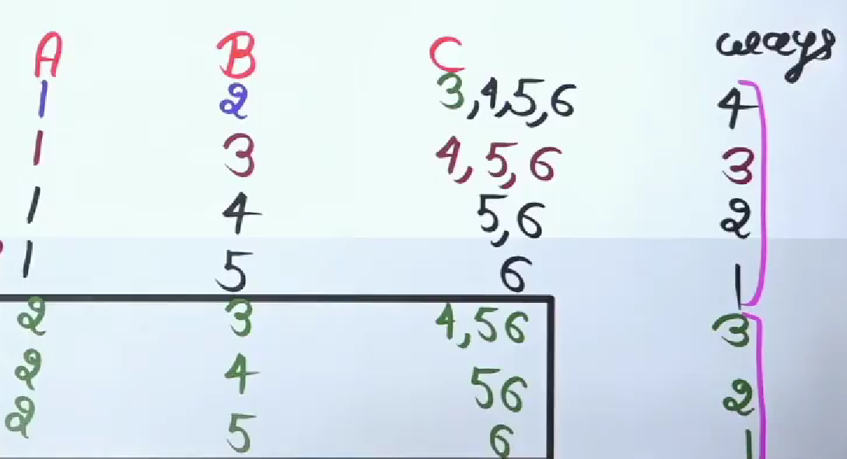
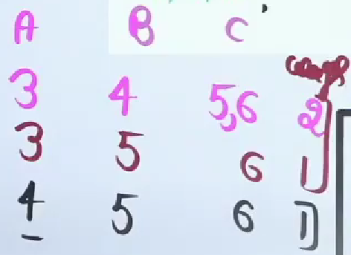
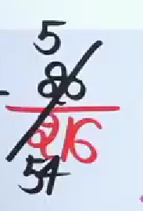
ANSWER:

Slide 29
Thank You

